Slide 1

The Velvet Revolution
Dockerizing Traditional .NET Apps
Elton Stoneman | Developer Advocate
@EltonStoneman | elton@docker.com

Slide 2
Today
The Docker platform
ASP.NET apps in Docker
Modernizing apps with Docker

Slide 3
Without any…
Microservices
DevOps
Cloud
.NET Core
Nano Server
Linux

Slide 4
v1
➔

GET


Slide 5
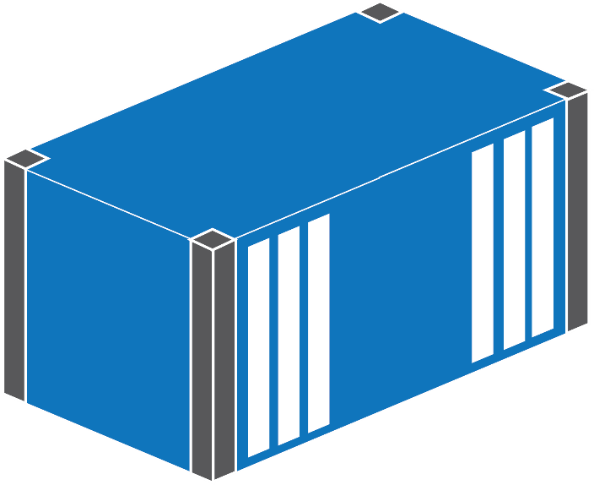
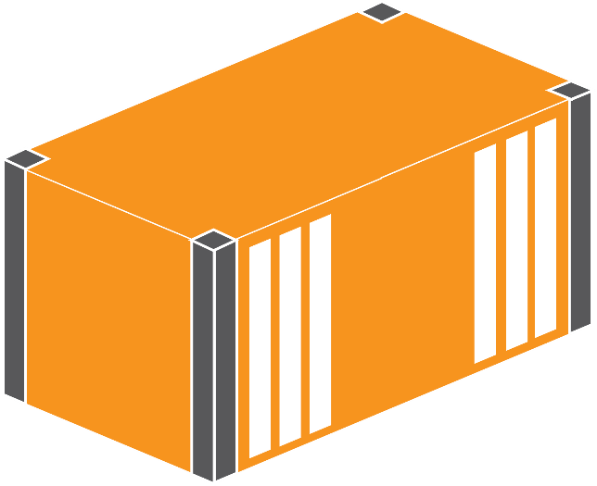
v2
➔
GET


Slide 6

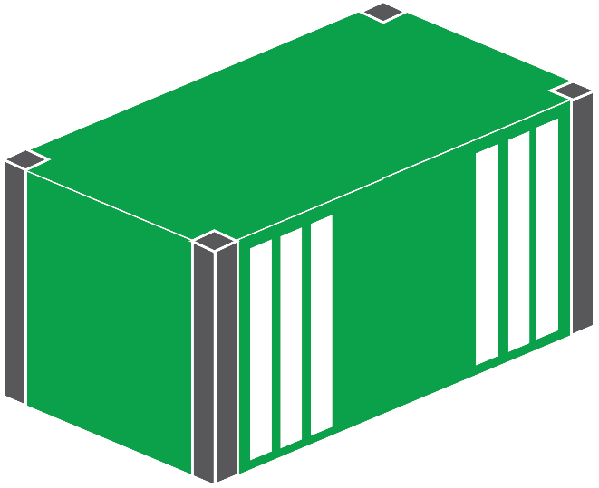
v3
➔
GET


→

Slide 7
v4
➔
GET



→



Slide 8
v5
➔
➔
GET



→



Slide 9
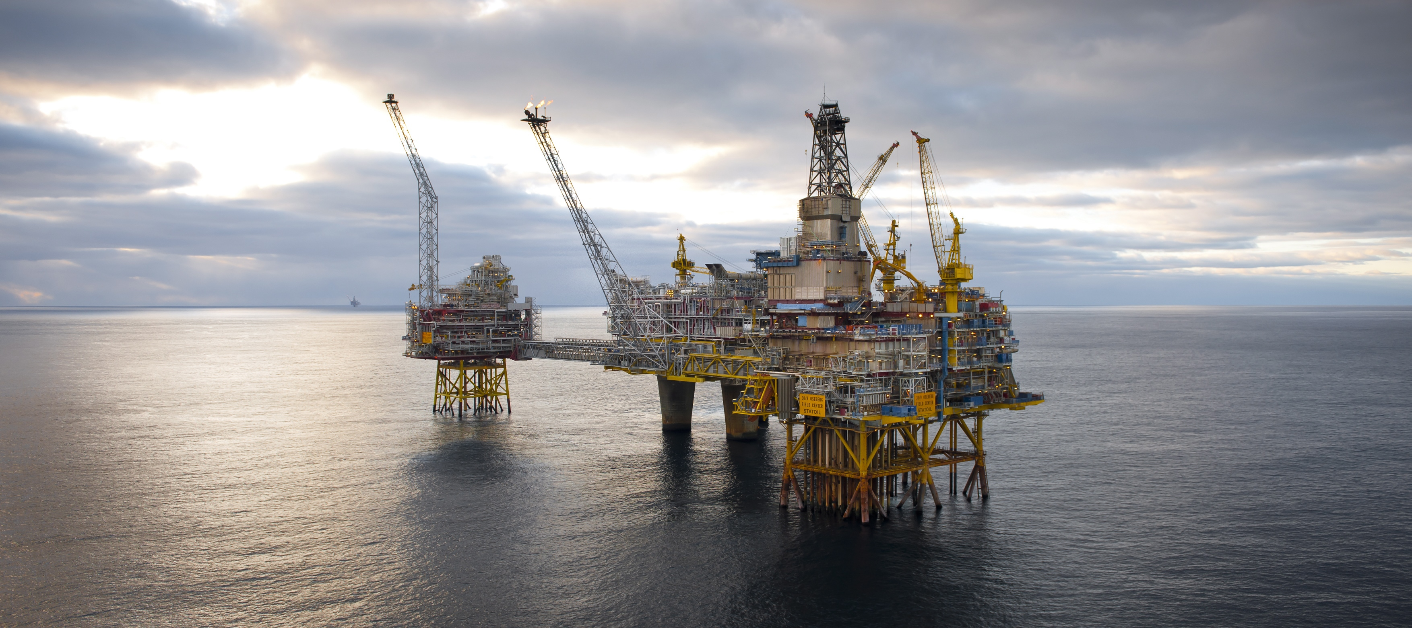

Docker is a Platform
Notes:
Packaging
Distributing
Running
Managing

Slide 10


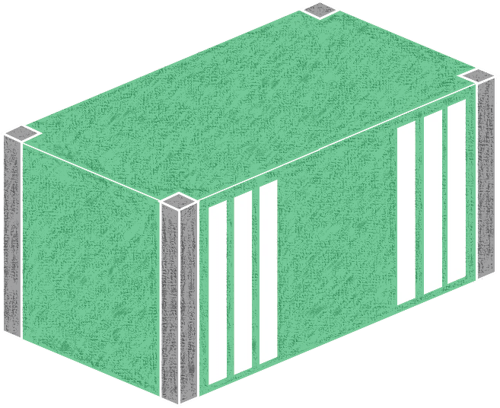

> docker build
Web App
ASP.NET
.NET Fx
IIS
Server Core

Slide 11
# escape=`
FROM microsoft/windowsservercore
SHELL ["powershell", "-Command"]
RUN Add-WindowsFeature Web-server, `
NET-Framework-45-ASPNET, Web-Asp-Net45; `
Remove-Website -Name 'Default Web Site'
COPY ProductLaunchWeb /product-launch-web
RUN New-Website -Name 'product-launch' `
-PhysicalPath 'C:\product-launch-web' -Port 80
EXPOSE 80
COPY bootstrap.ps1 /
ENTRYPOINT ./bootstrap.ps1

Slide 12

> docker push
hub.docker.com

Slide 13
Hub download slide

Slide 14




> docker run

Slide 15

http://vm:80

w3wp.exe

Slide 16


http://vm:80

w3wp.exe

w3wp.exe

w3wp.exe

Slide 17
Dockerizing ASP.NET

Slide 18
v2
Consistency
Build & store
Run & manage
Foundation
Fast, safe deployment
Break up monoliths
➔
GET


Slide 19
Modernizing Apps with Docker

Slide 20
Performance
Heavy usage crashes app
Data Insight
Support ticket for queries
UX
Full release for UI change

Slide 21
Performance
Heavy usage crashes app
Data Insight
Support ticket for queries
UX
Full release for UI change

Slide 22
Performance Feature Demo

Slide 23
v3
➔
GET


→

Slide 24

v3
➔
GET


→

Slide 25
Performance
Heavy usage crashes app
Data Insight
Support ticket for queries


Slide 26
Data Insight Feature Demo

Slide 27
v4
➔
GET



→



Slide 28


v4
➔
GET



→



Slide 29
Performance
Heavy usage crashes app
Data Insight
Support ticket for queries
UX
Full release for UI change



Slide 30
UX Feature Demo

Slide 31
v5
➔
➔
GET



→



Slide 32



v5
➔
➔
GET



→



Slide 33
Performance
Heavy usage crashes app
Data Insight
Support ticket for queries
UX
Full release for UI change




Slide 34
From
ASP.NET WebForms app
SQL Server database

Slide 35
To
Event-driven architecture
Self-service analytics
Self-service content

Slide 36
Takeaways
Docker is a mature platform
Moving apps into Docker is easy
Dockerizing enables modernizing

Slide 37


Slide 38
What Next?
Docker Labs github.com/docker/labs
Docker Captains on Twitter https://is.gd/7nU0if
DockerCon
Texas, April 17-20
Copenhagen, October 16-18
@EltonStoneman

